Slide 1
ROSES (Rosa spp.)
Rosaceae
DIFFERENT TYPES
• TEA ROSES
• HYBRID TEA
• HYBRID PERPETUALS
• POLYANTHUS
• FLORIBUNDA
• GRANDIFLORA
• CLIMBERS

Slide 2
TEA ROSES
• Having the smell of tea
• Its also called China rose
• Stem is not hard
• Have no. of small branches
• Needs good sunlight flower buds of this class are longer and look beautiful.

Slide 3


Slide 4
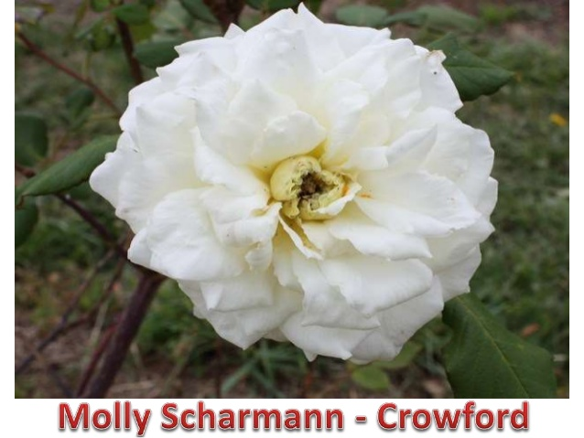

Slide 5
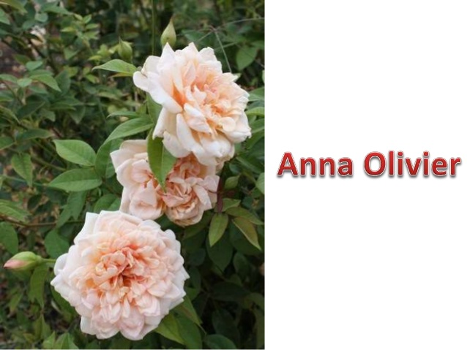

Slide 6
HYBRID TEA
• The flower buds are longer and look beautiful.
• The flowers slow opening and hence can be kept in vases for a longer time.
• The flower spikes are also longer.
• Flowers of wide range of colours.

Slide 7


Slide 8
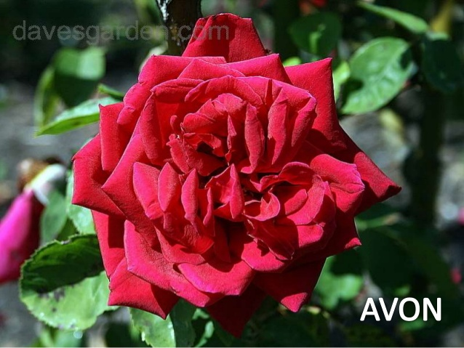

Slide 9
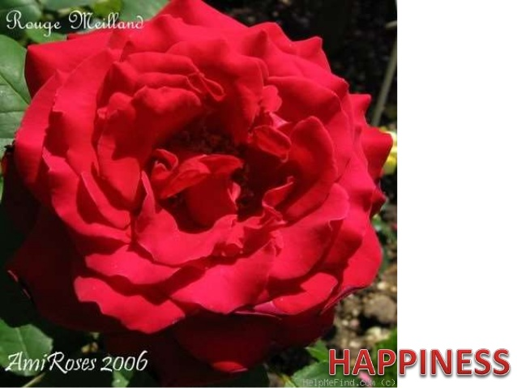

Slide 10


Slide 11


Slide 12


Slide 13


Slide 14


Slide 15
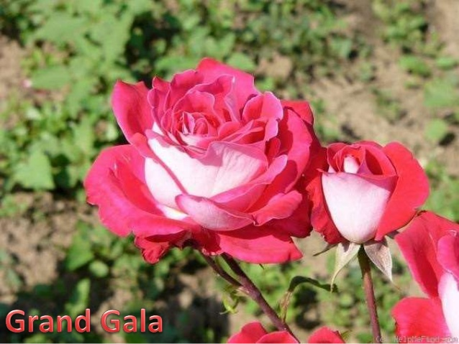

Slide 16
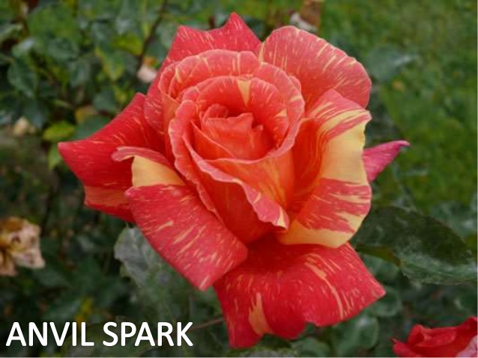

Slide 17
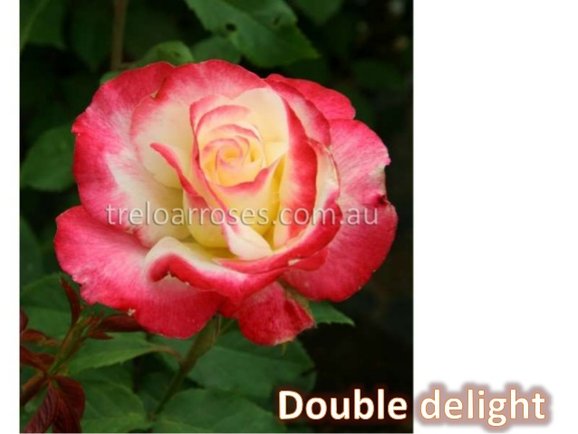

Slide 18


Slide 19


Slide 20
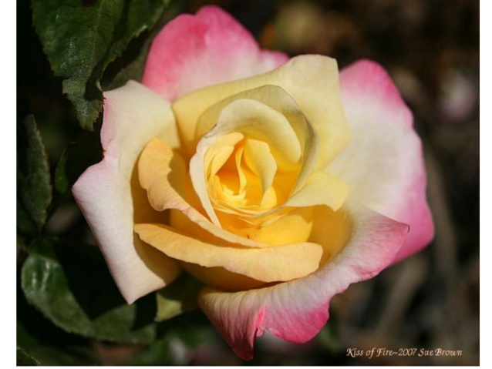

Slide 21
HYBRID PERPETUALS
• It produces flowers more than one season
• Produces Big sized flowers
• Strong and Hard stem
• Good smelling
• Needs pruning

Slide 22
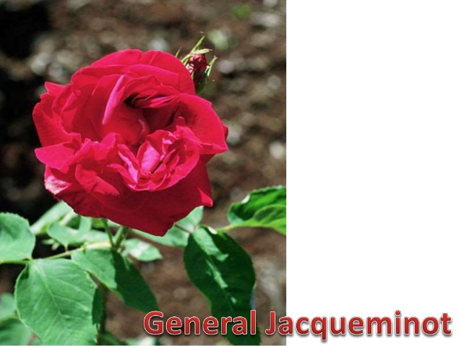

Slide 23
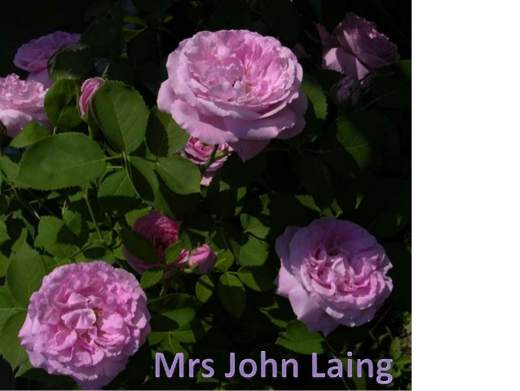

Slide 24
POLYANTHUS
• Short plants
• Continuous flowering type
• Flowers come in clusters
• Light pruning is required

Slide 25
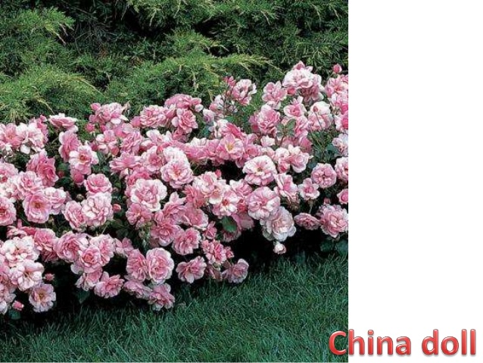

Slide 26
FLORIBUNDA
• Hybrid Tea X Polyanthus
• Profuse flowering in bunches
• Flowers shed fast
• Used for bedding and decoration

Slide 27


Slide 28
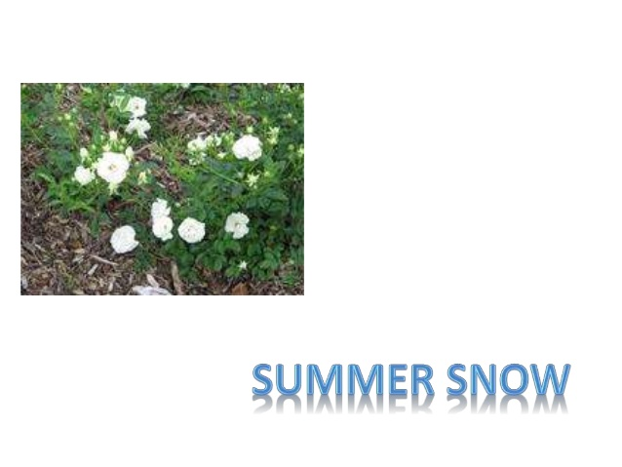

Slide 29


Slide 30


Slide 31


Slide 32


Slide 33


Slide 34
GRANDIFLORA
• Hybrid tea X Floribunda
• Produces flowers in bunches – June bride – Queen Elizabeth

Slide 35
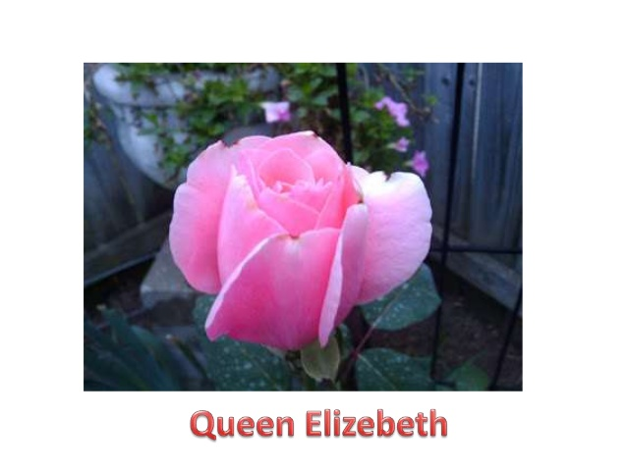

Slide 36
MINIATURE
• Known as Baby roses
• Small leaves and flowers
• Dwarf in stature
• Used in flower arrangement

Slide 37
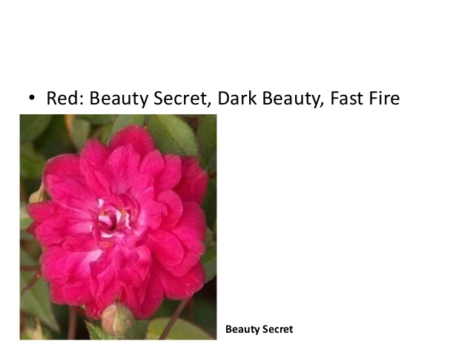

Slide 38
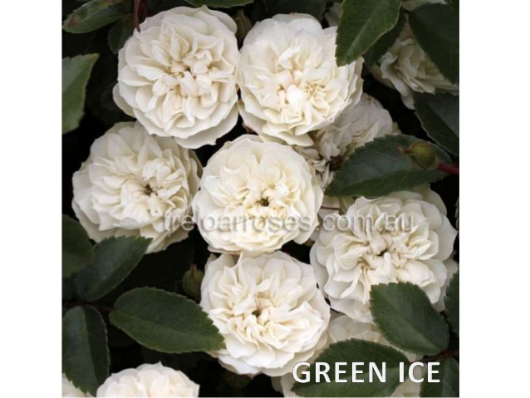

Slide 39
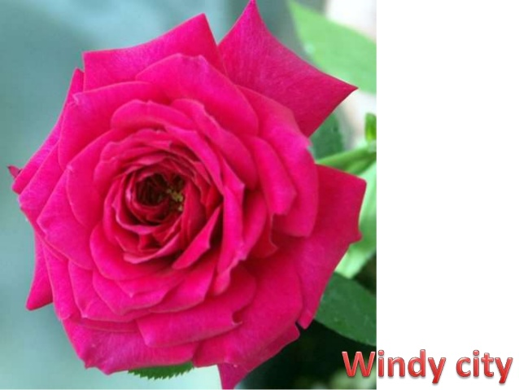

Slide 40
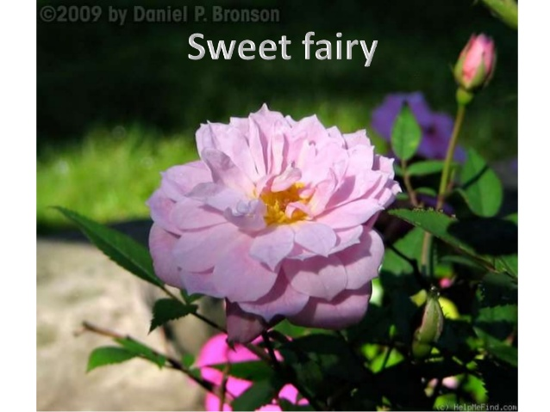

Slide 41
CLIMBERS
• The branches of these roses are soft and spread like climber.
• Flower at the end of the branches in small clusters.
• Used for raising over the pergolas and the walls.

Slide 42
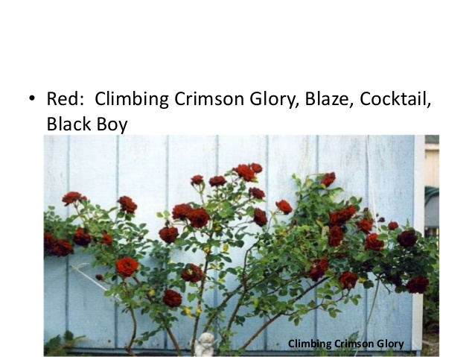

Slide 43
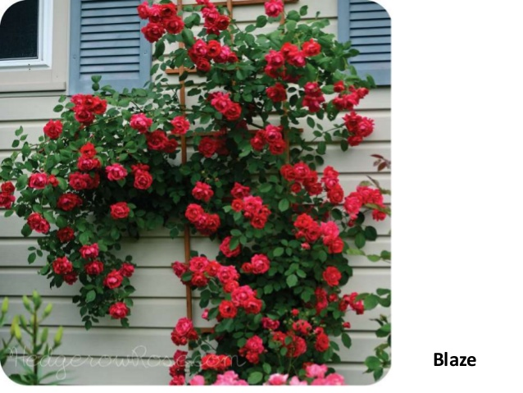

Slide 44
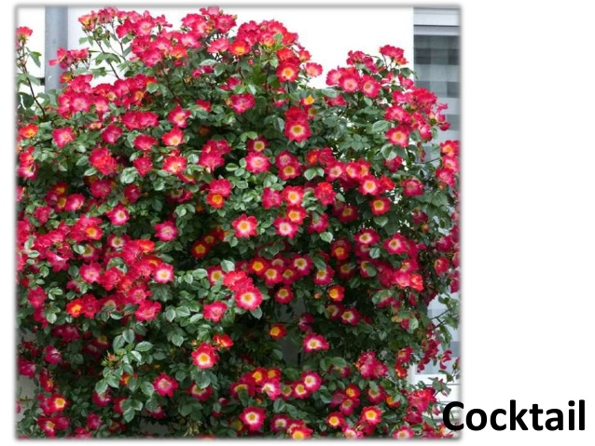

Slide 45
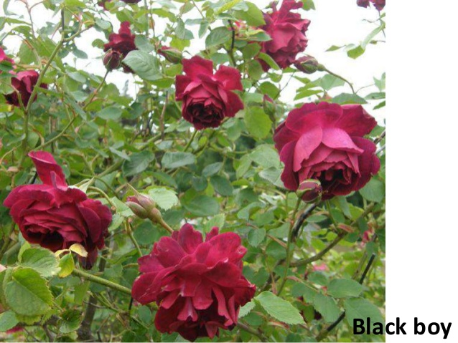

Slide 46
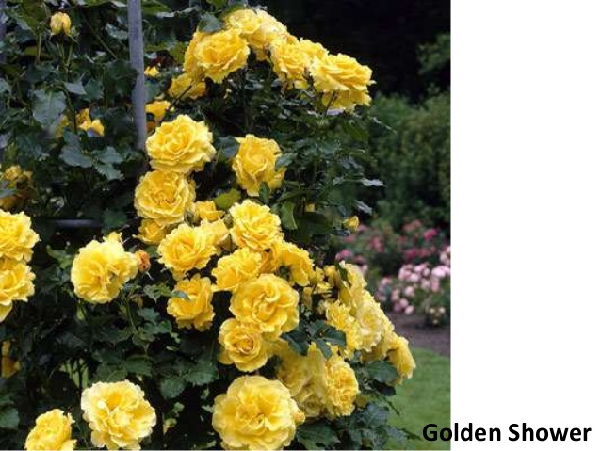

Slide 47
GERBERA
(Gerbera jamesonii)

Slide 48
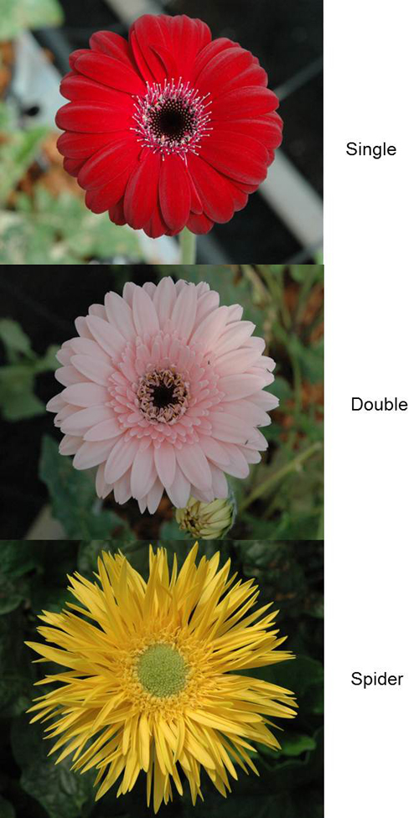

Slide 49
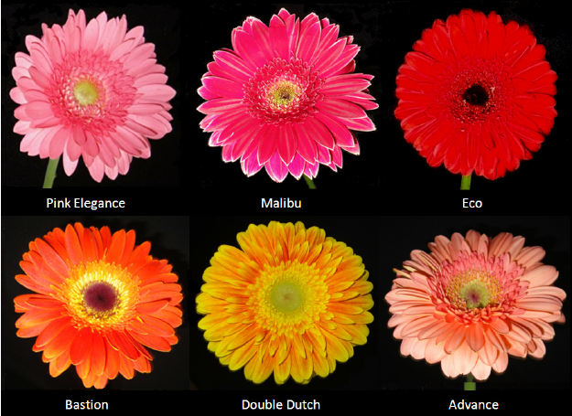

Slide 50
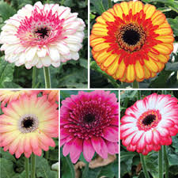

Slide 51
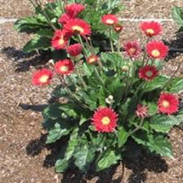

Slide 52
CHRYSANTHEMUM (Chrysanthemum grandiflorum)

Slide 53
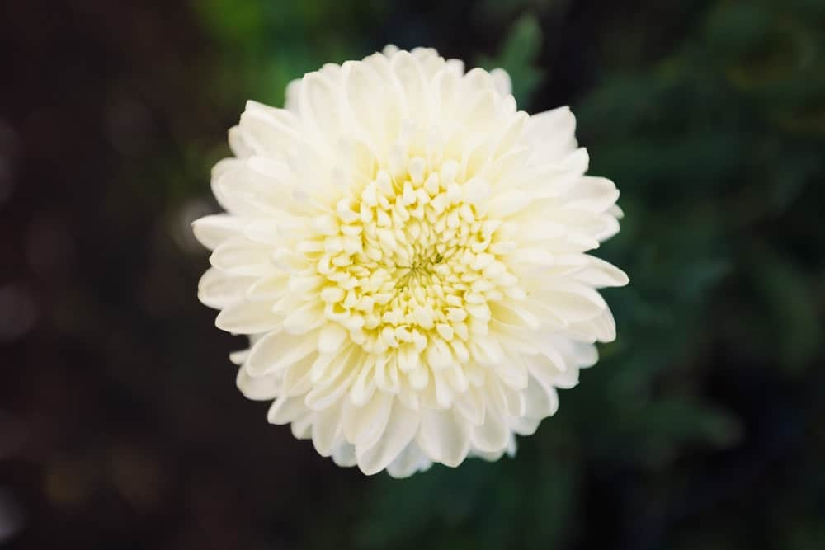
SINGLE BLOOM

Slide 54
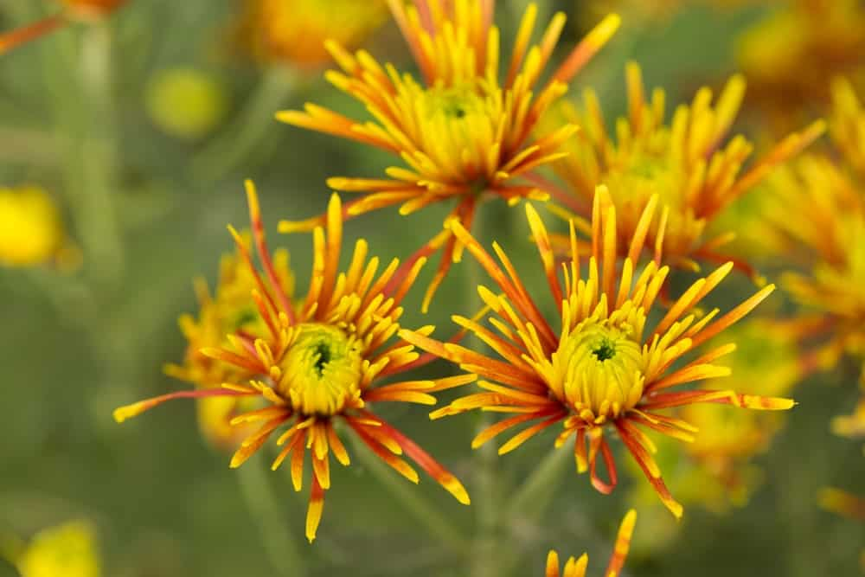
QUILLED BLOOM

Slide 55
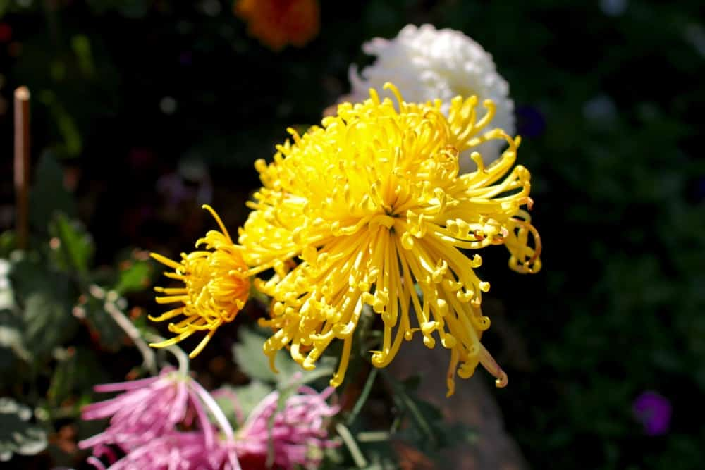
SPIDER BLOOM

Slide 56
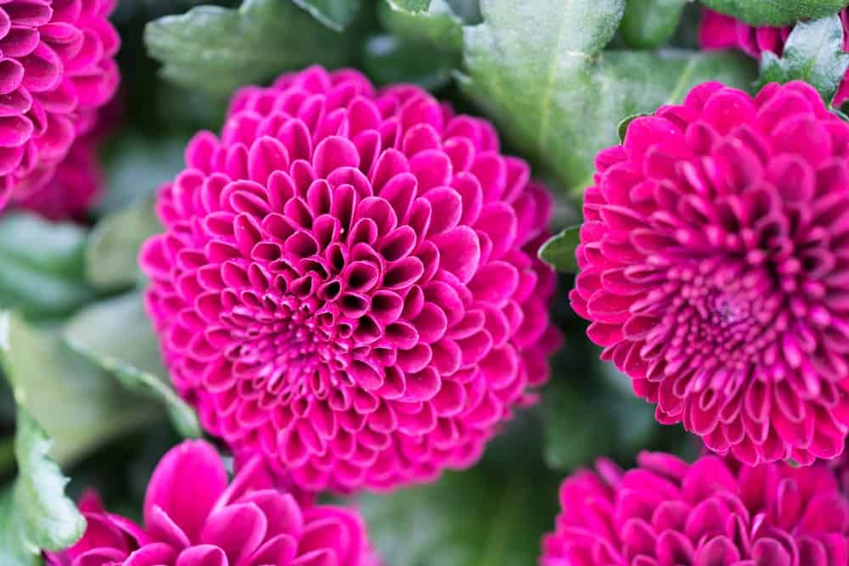
POMPONS

Slide 57
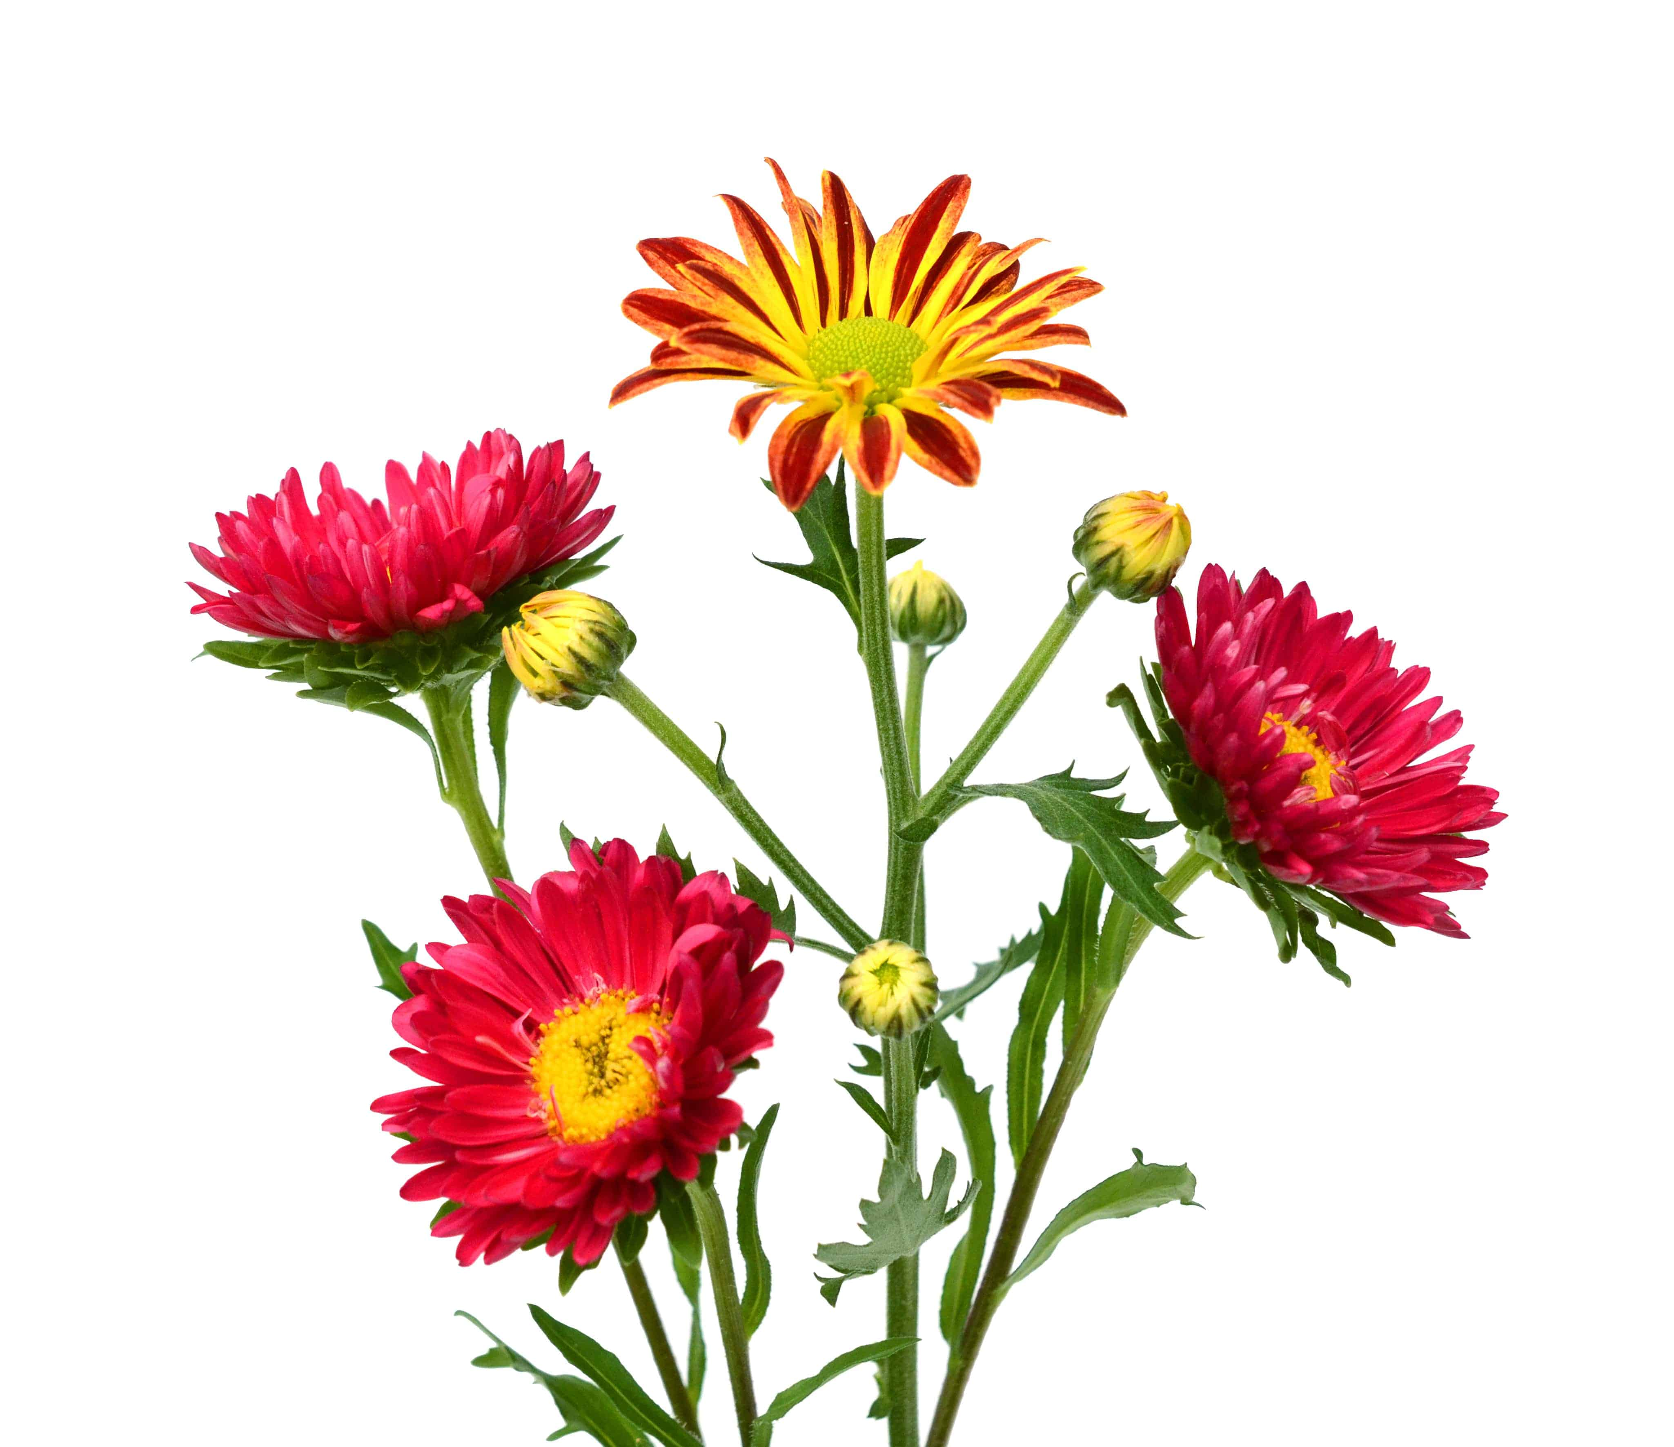
REFLEX AND INCURVE BLOOMS

Slide 58
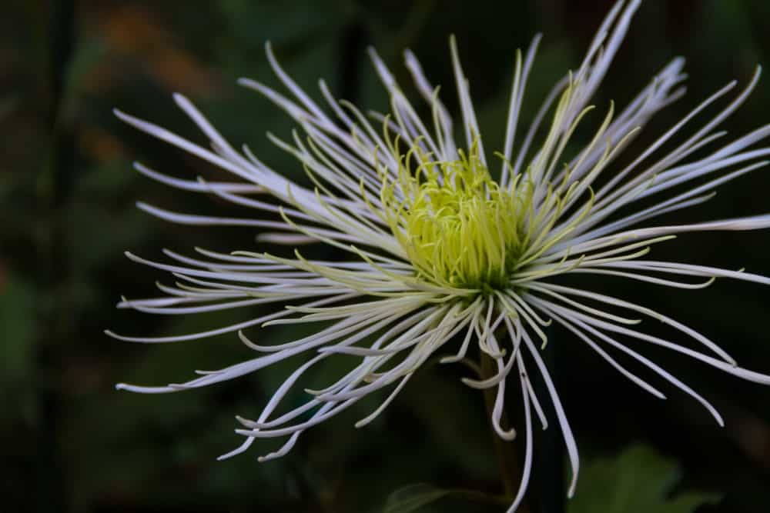
BRUSH OR THISTLE CHRYSANTHEMUMS

Slide 59
CARNATION
(Dianthus caryophyllus)

Slide 60
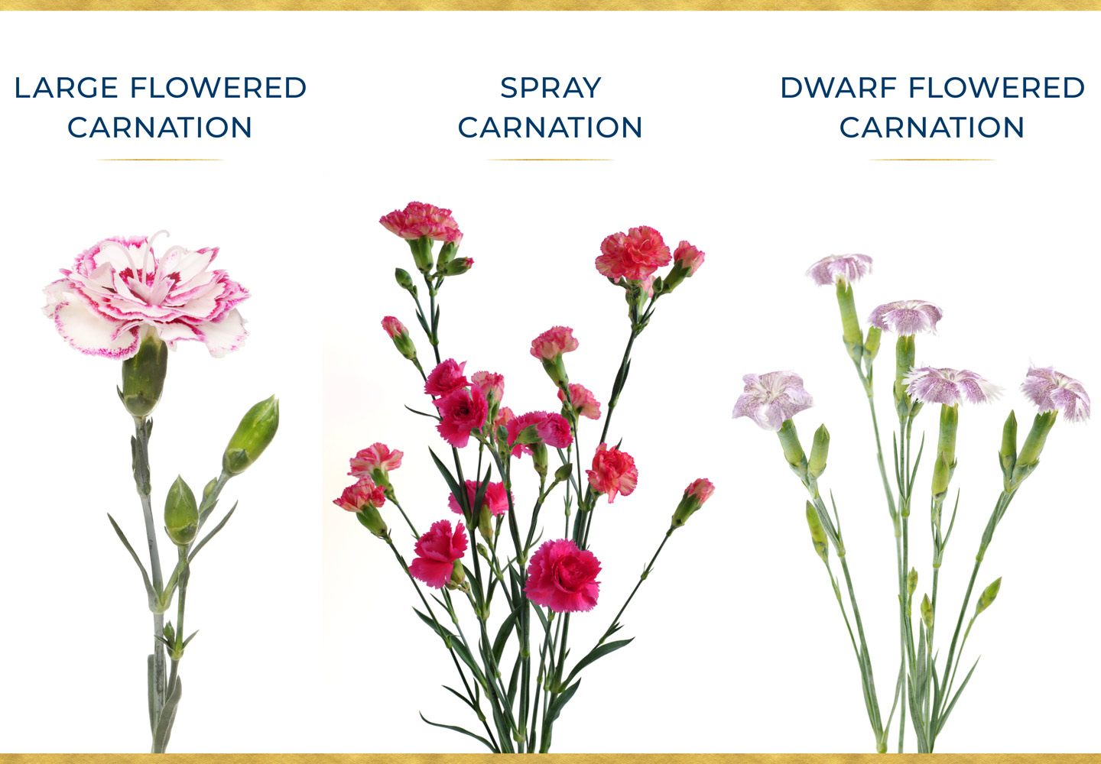

Slide 61
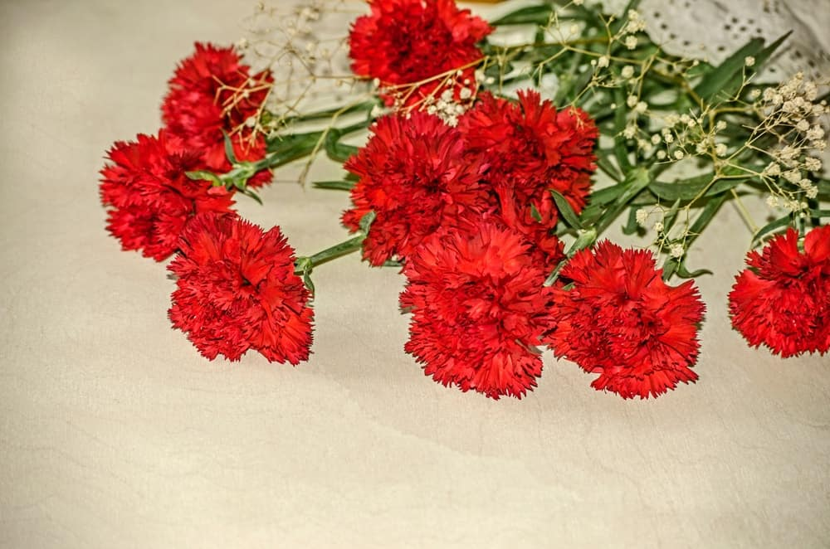
Large flowers, with one big flower per stem.

Slide 62
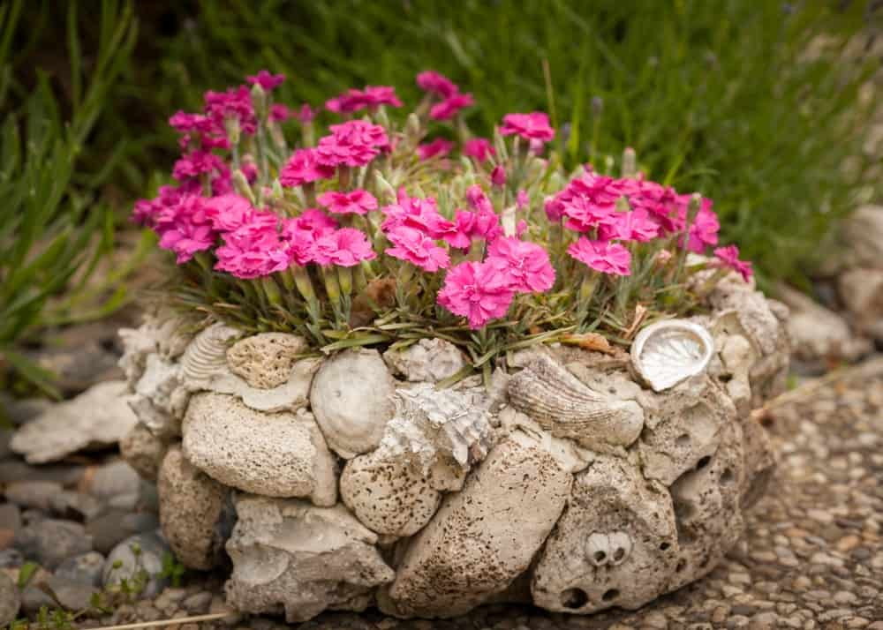
Dwarf flower, smallest type of carnation

Slide 63
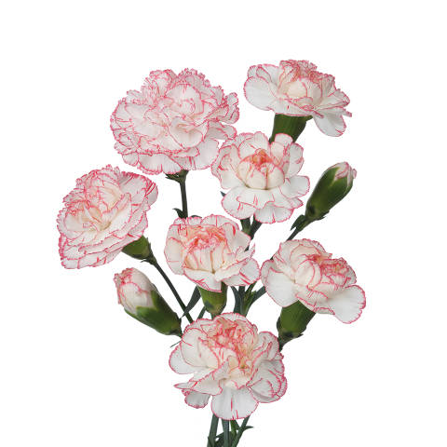
Spray flowers, with several smaller flowers per stem

Slide 64
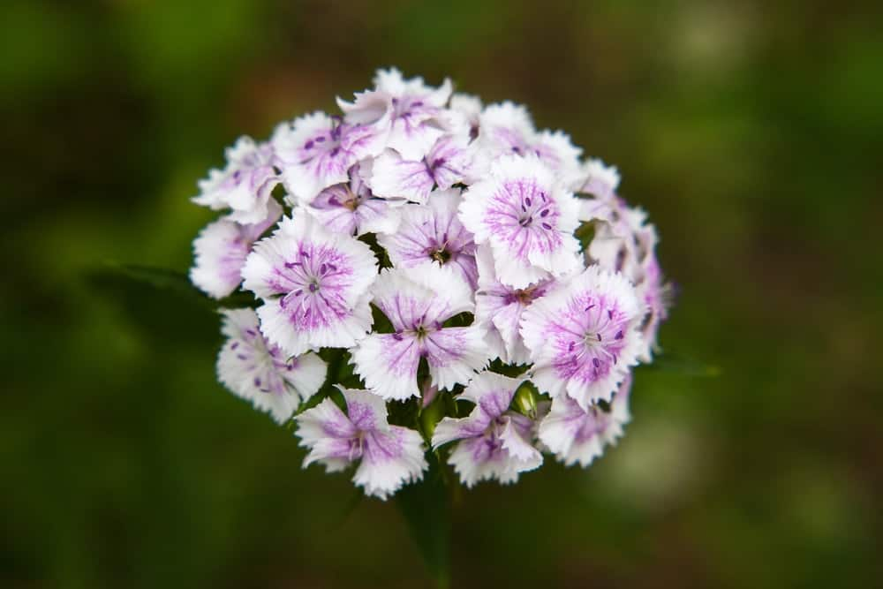
Dianthus barbetus (Sweet William)
This type of carnation will germinate and grow the first year you plant them. In the second year, they start to bloom, and you get new crops every year thanks to the fact that they easily reseed. One of the biggest advantages of the Sweet William carnation is that it grows in all conditions and therefore, people living in any part of the country can grow it. Sweet Williams are usually salmon, pink, white, or red, and they have an exceptional fragrance and aroma.

Slide 65
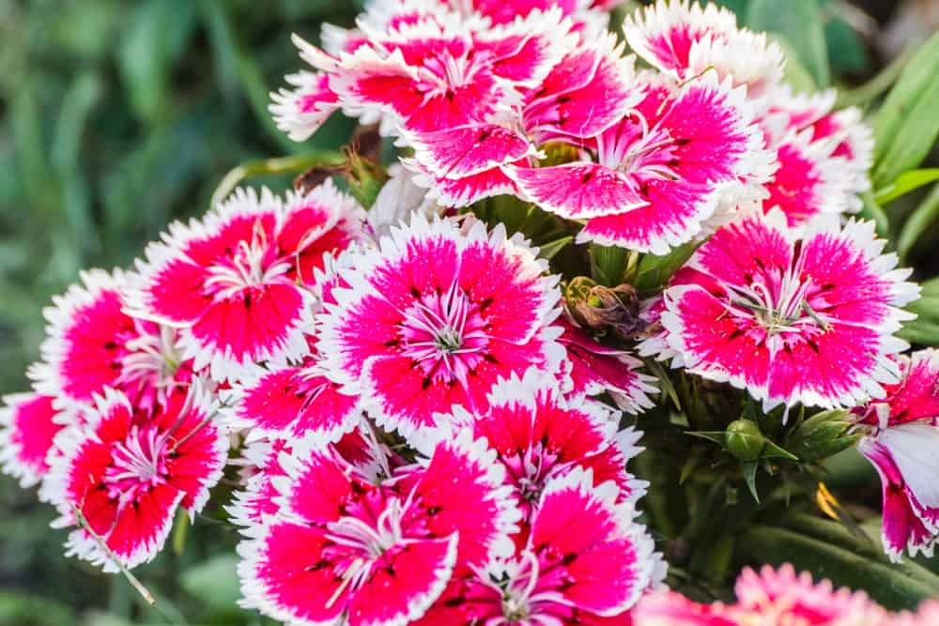
Dianthus chinensis (Hardy annuals)

Slide 66
TUBEROSE
(Polianthes tuberosa)

Slide 67
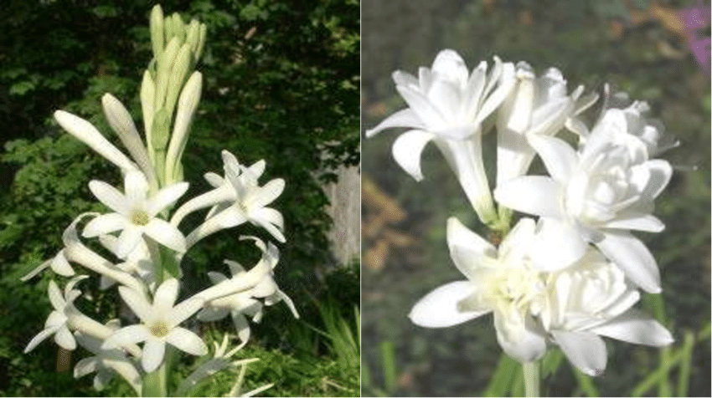
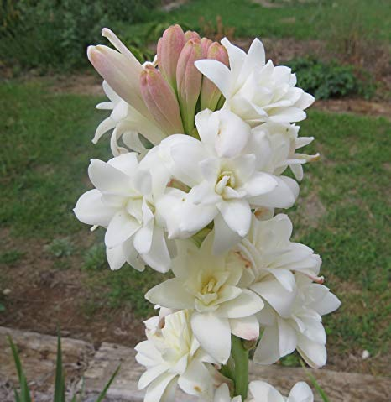
Single type
Double type

Slide 68
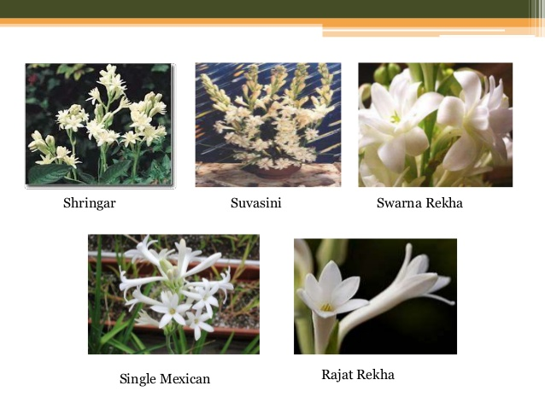

Slide 69
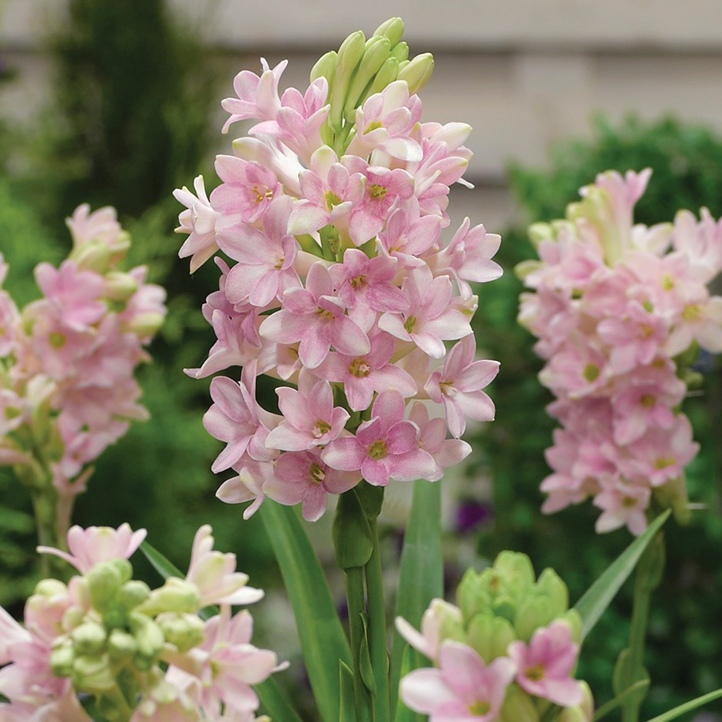

Slide 70
Jasmine (Jasminum spp.)

Slide 71
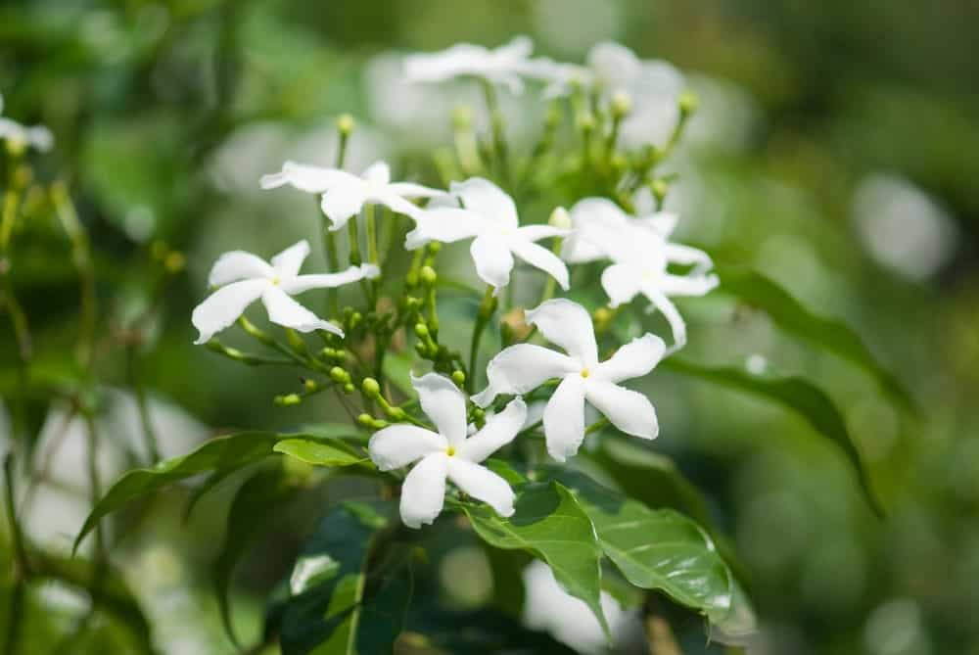
Crape jasmine or common jasmine (Jasminum officinale)
It is commonly known as Poet’s Jasmine, White Jasmine, Common White Jasmine or True Jasmine. This deciduous climber features pristine five-petaled white flowers with slightly fuzzy and pointed leaves. These jasmines bloom heavily during the summer. This evergreen plant grows fast and can reach heights of up to 15 feet when fully matured.

Slide 72
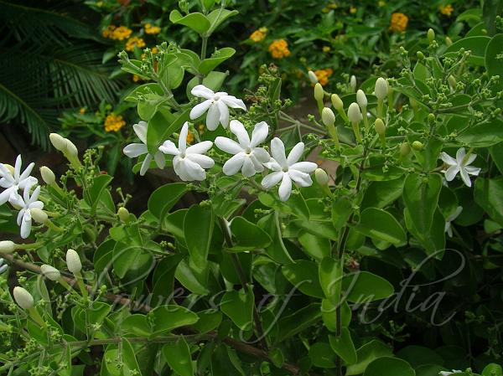
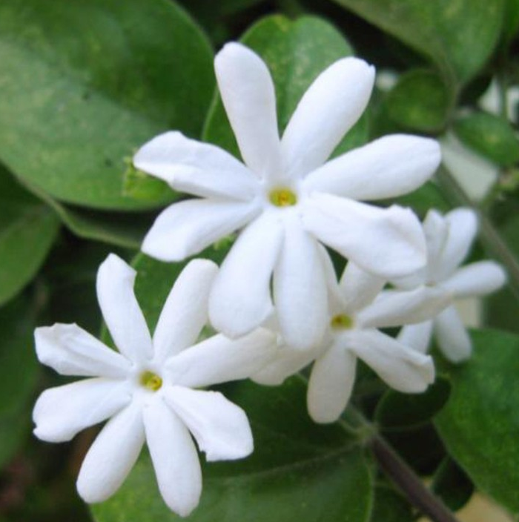
Juhi (Jasminum auriculatum)
“Juhi” Jasminum auriculatum is a small, evergreen, climbing shrub having beautiful flower with extremely heavy gardenia type scent. This species is not very common though it deserves a special attention. It is a stunning, small climbing bushy plant with simple ovate dark green small leaves and powdery satin white flowers.

Slide 73
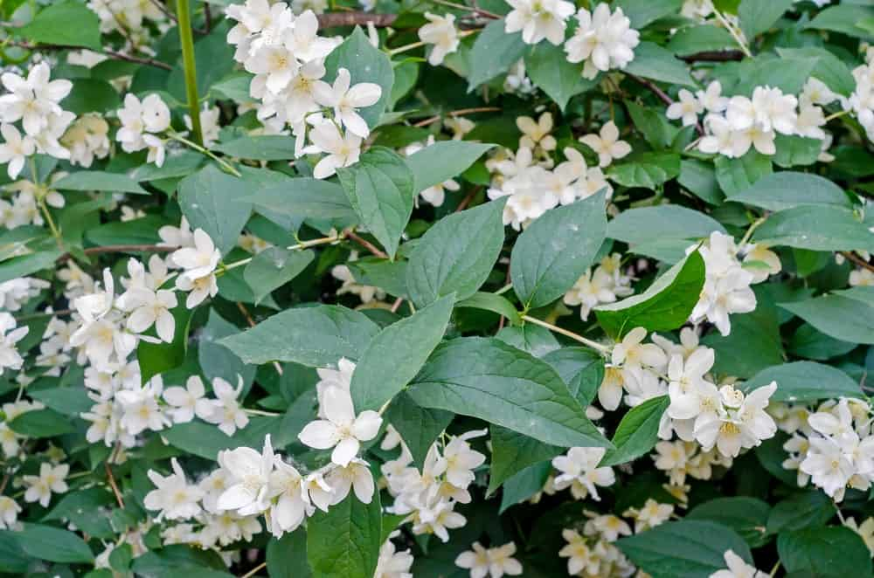
Royal or Spanish Jasmine (Jasminum grandiflorum)
Jasminum Grandiflorum, also called Royal jasmine, Spanish Jasmine or Catalonian Jasmine is a subset of the Jasminum officinale species. The difference is that unlike the common jasmine, this variety is often grown for the food industry besides being used in making perfumes. It features pure white flowers that grow about an inch apart on a vine that is evergreen in frost-free areas but semi-evergreen in cold regions.

Slide 74
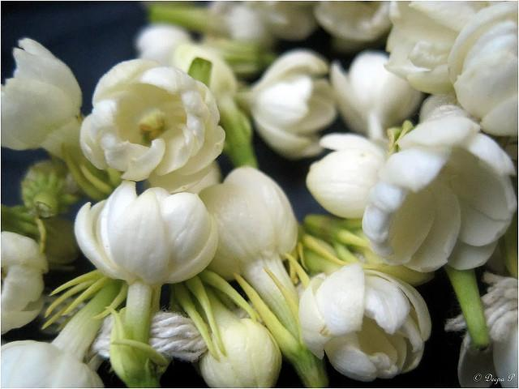
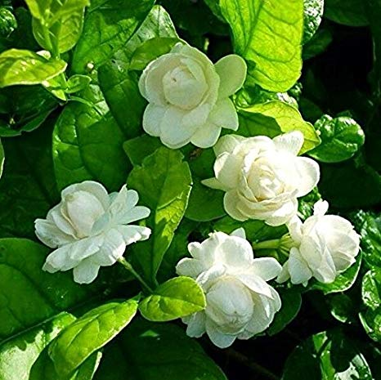
Arabian jasmine or Mogra (Jasminum sambac)
This type of jasmine which is native to the Arab Peninsula is best suited to warm environments. Although the shrubs of mogra are typically 4 to 6 feet in width and height, some can often grow up to 10 feet tall. These shrubs can be trained to grow vertically, where they create a lush evergreen vine. Arabian jasmines comprise of small but captivating white multi-layered flowers that look simply exquisite against the glossy, dark green leaves. The blooms often turn faded pink when they reach maturity.

Slide 75
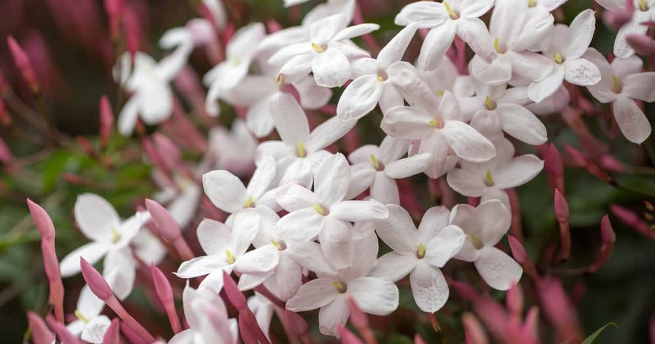
Pink Jasmine (Jasminum polyanthum)

Slide 76
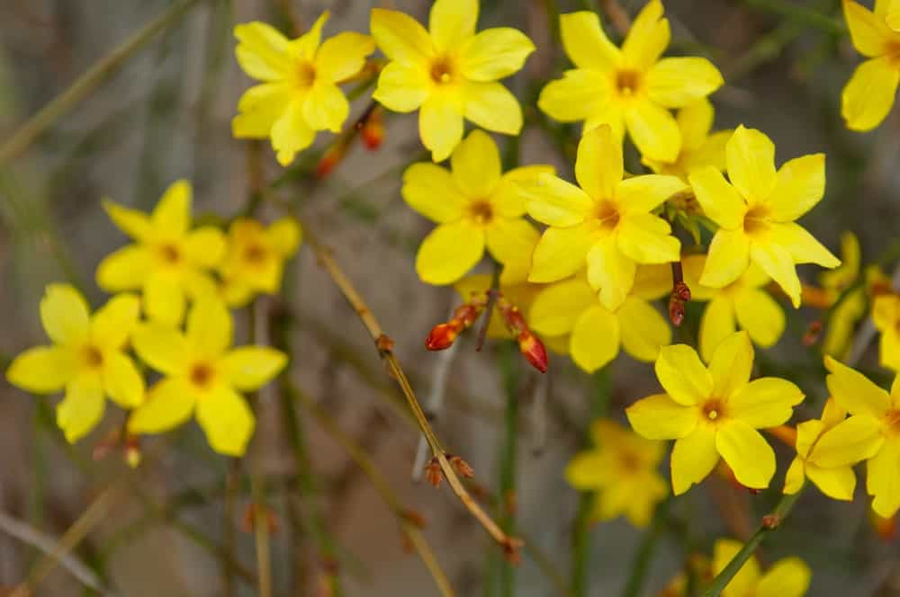
Winter or Yellow Jasmine (Jasminum nudiflorum)

Slide 77

Types of false jasmine: Cestrum Nocturnum (Night-Blooming Jasmine/ Rat ki rani)

Slide 78
MARIGOLD
Marigold has 2 genera which are referred to as Tagetes and Calendula.
Marigolds are easy to grow overall and easy to maintain. Some of their biggest advantages include:
Long growing season
Easy to care for
Can repel pests such as Mexican bean beetles when planted with herbs and vegetables,
Many decorative uses because of their beauty and size
Edible options available

Slide 79


African or Mexican or American Marigold (Tagetes erecta)
The African marigolds (Tagetes erecta) have large, double, yellow-to-orange flowers from midsummer to frost. Flowers may measure up to 5 inches across. Plant height varies from 10 to 36 inches. African marigolds are excellent bedding plants. Tall varieties can be used as background plantings. Suggested African marigolds for Iowa include varieties in the Inca and Perfection series.

Slide 80


French Marigold (Tagetes patula)
The French marigolds (Tagetes patula) are smaller, bushier plants with flowers up to 2 inches across. Flower colors are yellow, orange, and mahogany-red. Many varieties have bicolored flowers. Flower heads may be single or double. Plant height ranges from 6 to 18 inches. The French marigolds have a longer blooming season than the African marigolds. They generally bloom from spring until frost. The French marigolds also hold up better in rainy weather. French marigolds are ideal for edging flower beds and in mass plantings. They also do well in containers and window boxes. Queen Sophia and Golden Gate are excellent French marigold varieties.

Slide 81


Triploid marigold (Tagetes erecta x Tagetes patula)
ZENITH
The triploid hybrids are crosses between the tall, vigorous African marigolds and the compact, free-flowering French marigolds. Triploid hybrid marigolds are unable to set seed. As a result, plants bloom repeatedly through the summer, even in hot weather. One problem with the triploids is their low seed germination rate. Average germination is around 50 percent. Since the triploid hybrids are unable to produce viable seed, they also know as mule marigolds.

Slide 82

Signet (Single) Marigolds (Tagetes tenuifolia)
Signet marigolds (Tagetes tenuifolia) are quite different from most marigolds. Signet marigold plants are bushy with fine, lacy foliage. The small, single flowers literally cover the plants in summer. Flower colors range from yellow to orange. They are also edible. The flowers of signet marigolds have a spicy tarragon flavor. The foliage has a pleasant lemon fragrance. Signet marigolds are excellent plants for edging beds and in window boxes.

Slide 83


Pot Marigold (Calendula officinalis)
Calendula officinalis, the pot marigold, ruddles, common marigold or Scotch marigold is a plant in the genus Calendula of the family Asteraceae. Calendula officinalis is a short-lived aromatic herbaceous perennial. Although perennial, it is commonly treated as an annual, particularly in colder regions where its winter survival is poor, and in hot summer locations where it also does not survive.
It is also used for treating sore throat and mouth, menstrual cramps, cancer, and stomach and duodenal ulcers. Calendula has also been used for measles, smallpox, and jaundice. Calendula is applied to the skin to reduce pain and swelling (inflammation) and to treat poorly healing wounds and leg ulcers.

Slide 84


GLADIOLUS

Slide 85



LILIUM

Slide 86


Elephant amaranthus
Love lies bleeding amaranthus

Slide 87





PETUNIA

Slide 88


VERBENA

Slide 89




VINCA (PERIWINKLE)

Slide 90



ZINNIA

Slide 91



ASTER

Slide 92


ANTIRRHINUM

Slide 93


DAHLIA

Slide 94


DAFFODIL

Slide 95

PANSY

Slide 96



ORCHIDS

